Slide 1
UNITS 1 & 2 ATAR HUMAN BIOLOGY
CHAPTER 13 – DNA: THE CODE FOR LIFE

Slide 2
DNA
Short for deoxyribonucleic acid or deoxyribose nucleic acid
Found in the cells of all organisms
Contains information to determine cell structure and how it functions
2–3 metres long but only 2 millionths of a millimetre thick.
Sections of the DNA molecules make up the genes which contain the genetic code, which is the stored information that determines the structure and activities of the cell.

Slide 3

DNA (cont’d)
DNA is found in the nucleus of cells and contains the code (the genes) that is required to manufacture the specific proteins required in the body.
It is made up of nucleotides. Nucleotides consist of a sugar, a phosphate group and one nitrogen base. The bases are adenine, thymine, guanine and cytosine.
The nucleotides join together to form a long double stranded molecule known as a double helix.

Slide 4
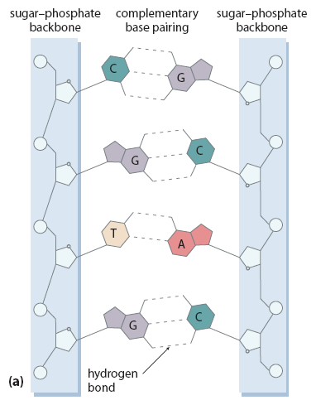
DNA components
Phosphate
Deoxyribose Sugar
Nitrogen bases
Nucleotide

Slide 5
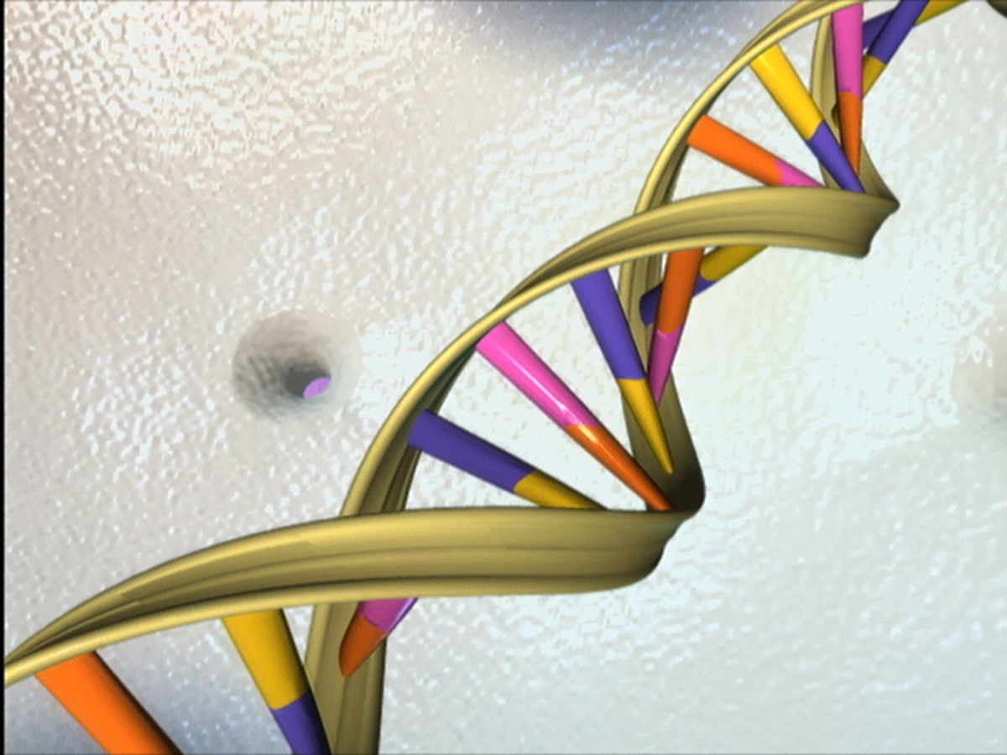

Slide 6

Nitrogenous Bases
There are four nitrogen bases, and they pair together in a certain way:
Adenine (A) with
Thymine (T)(2 hydrogen bonds)
Cytosine (C) with
Guanine (G) (3 hydrogen bonds)
One gene can be comprised of 1000 pairs of these bases.

Slide 7
The nitrogen bases have complementary shapes
A T
C G

Slide 8
Compacting the DNA
YouTube – DNA compaction and replication
Special proteins called histones provide anchors for DNA
The DNA coils around the histones to conserve space
Without these histones, DNA would freely “float” in the nucleoplasm, wasting space.
The DNA wrapped around the histone proteins is then termed “chromatin”

Slide 9
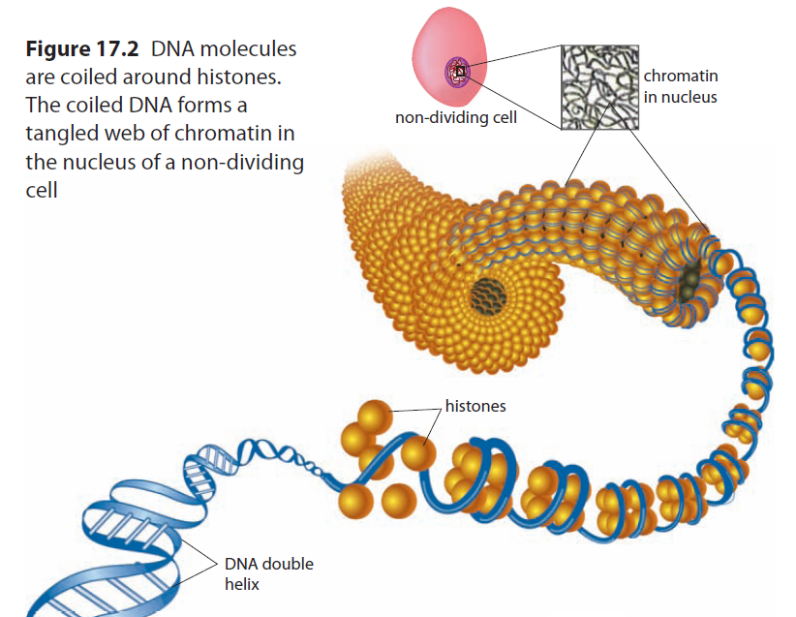

Slide 10
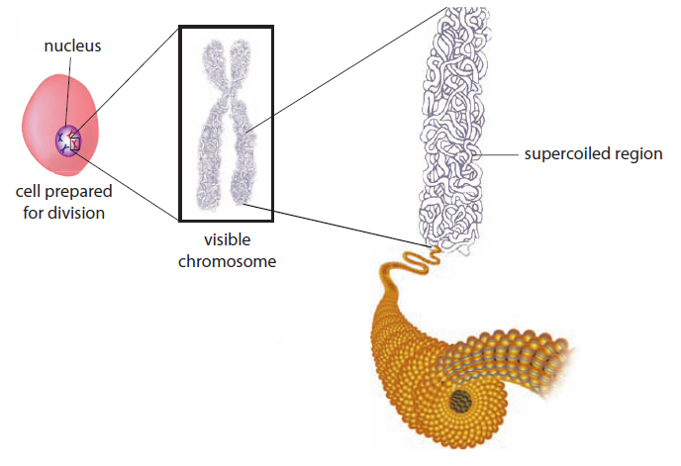


Slide 11
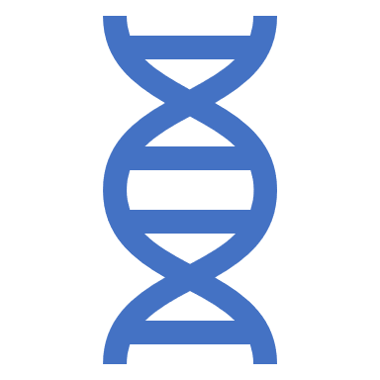
DNA replication
YouTube - DNA Replication
So that each cell can make an exact copy for growth and repair, the DNA must make a copy of itself
This process is called “replication” and involves the double-stranded DNA molecule “unzipping”.
There are many “free” nucleotides inside a nucleus , from which DNA replication is possible
When the DNA strand unzips, the nitrogenous base pairs separate exposing their active sites for attachment to the free nucleotides
Free nucleotides attach to their exposed opposite base creating a new pair of bases attached to one strand of the DNA
The sugar-phosphate side-chain molecules bond together and a new double-stranded DNA molecule is formed.

Slide 12

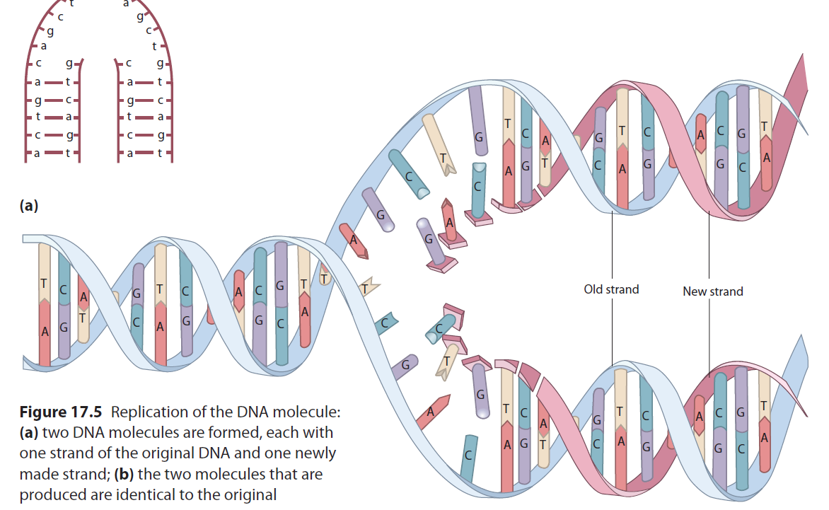


DNA Replication clip: https://www.youtube.com/results?search_query=dna+replication+amoeba+sisters
Sample Footer Text
8/13/2019
12

Slide 13
Role of DNA in the cell
The genetic code in the DNA provides the instructions for protein synthesis—making proteins in the cell.
Synthesis is the combining of small molecules to make larger molecules.
For example, proteins are synthesised from amino acids.
A gene then is a specific set of “instructions” for the manufacture of a specific protein.

Slide 14

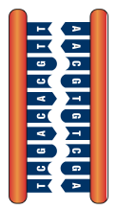

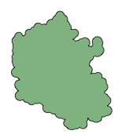

Genes to Proteins
The central dogma of molecular biology for the past 50 years has stated that genetic information, encoded in DNA, is transcribed into molecules of RNA, which are then translated into the amino acid sequences that make up proteins. This simple view is still useful.
The nature of a protein determines its role in the cell.
Reverse transcription is carried out by some RNA viruses. It converts viral RNA into DNA, which is incorporated into the host’s genome.
Amino acid
Structural?
tRNA
Regulatory?
Reverse transcription
Contractile?
Immunological?
Transcription
Translation
Transport?
Protein
DNA
mRNA
Catalytic?

Slide 15

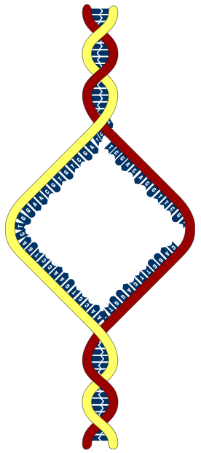
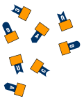

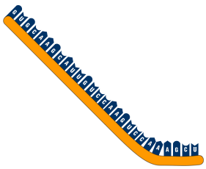
Transcription
DNA
A mRNA strand is formed using the DNA molecule as the template.
Free nucleotides with bases complementary to the DNA are joined together by the enzyme RNA polymerase.
Single-armed
chromosome as found in non-dividing cell
Free nucleotides
used to construct
the mRNA strand
RNA polymerase enzyme
Template strand of DNA contains the information for the construction of a functional mRNA product (e.g. a protein)
Direction of synthesis
Coding strand
The two strands of DNA coil up into a double helix
Formation of a single strand of mRNA that is complementary to the template strand (therefore the same “message” as the coding strand)

Slide 16
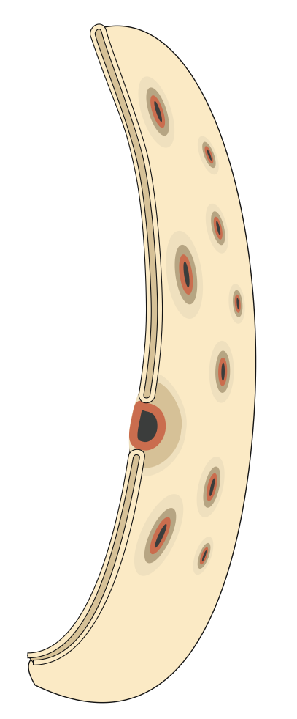
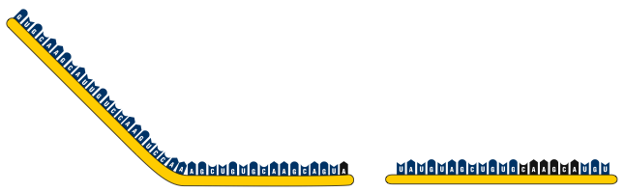

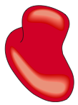
Movement of mRNA
In eukaryotic cells, the two main steps in protein synthesis occur in separate compartments: transcription in the nucleus and translation in the cytoplasm.
mRNA moves out of the nucleus, to the cytoplasm, through pores in the nuclear membrane.
In prokaryotic cells, there is no nucleus, and the chromosome is in direct contact with the cytoplasm, and protein synthesis can begin even while the DNA is being transcribed.
Ribosomes
mRNA
Nuclear pore through
which the mRNA passes
into the cytoplasm
Nucleus
Cytoplasm

Slide 17
mRNA Codes for Amino Acids
Read second letter here
Second Letter
Read third letter here
Read first letter here
 | U |  | C |  | A |  | G
U | UUU | Phe | UCU | Ser | UAU | Tyr | UGU | Cys | U
 | UUC | Phe | UCC | Ser | UAC | Tyr | UGC | Cys | C
 | UUA | Leu | UCA | Ser | UAA | STOP | UGA | STOP | A
 | UUG | Leu | UCG | Ser | UAG | STOP | UGG | Try | G
C | CUU | Leu | CCU | Pro | CAU | His | CGU | Arg | U
 | CUC | Leu | CCC | Pro | CAC | His | CGC | Arg | C
 | CUA | Leu | CCA | Pro | CAA | Gln | CGA | Arg | A
 | CUG | Leu | CCG | Pro | CAG | Gln | CGG | Arg | G
A | AUU | Iso | ACU | Thr | AAU | Asn | AGU | Ser | U
 | AUC | Iso | ACC | Thr | AAC | Asn | AGC | Ser | C
 | AUA | Iso | ACA | Thr | AAA | Lys | AGA | Arg | A
 | AUG | Met | ACG | Thr | AAG | Lys | AGG | Arg | G
G | GUU | Val | GCU | Ala | GAU | Asp | GGU | Gly | U
 | GUC | Val | GCC | Ala | GAC | Asp | GGC | Gly | C
 | GUA | Val | GCA | Ala | GAA | Glu | GGA | Gly | A
 | GUG | Val | GCG | Ala | GAG | Glu | GGG | Gly | G
First Letter
Third Letter

Slide 18
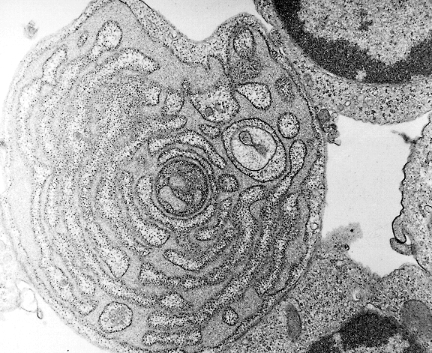
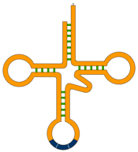

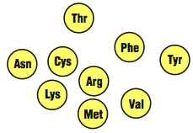
Translation
Translation is the process of building a polypeptide chain from amino acids, guided by the sequence of codons on the mRNA.
Structures involved in translation:
Messenger RNA molecules (mRNA) carries the code from the DNA that will be translated into an amino acid sequence.
Transfer RNA molecules (tRNA) transport amino acids to their correct position on the mRNA strand.
Ribosomes provide the environment for tRNA attachment and amino acid linkage.
Amino acids from which the polypeptides are constructed.
A heap of ATP – up to four ATP to create just one peptide bond
The speckled appearance of the rough endoplasmic reticulum is the result of ribosomes bound to the membrane surface.
mRNA
Ribosomes
tRNA
Amino acids

Slide 19


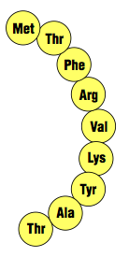







Overview of Translation
Activating
Lys-tRNA
Polypeptide chain in an advanced stage of synthesis
Activated Tyr-tRNA
Growing polypeptide
Unloaded Thr-tRNA
Start codon
Ribosome
mRNA
Ribosomes moving in this direction

Slide 20
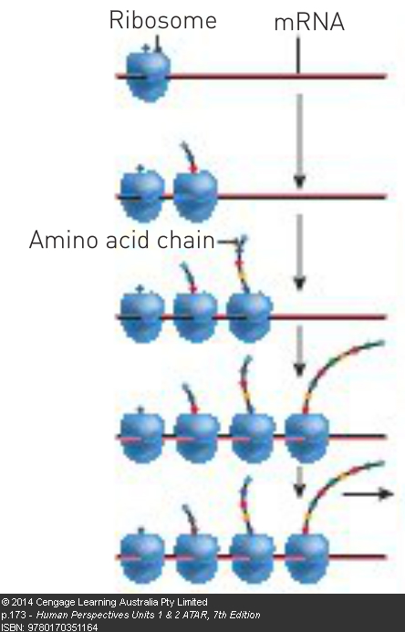
Protein Synthesis cont’d
When large amounts of a protein are required, more than one ribosome will be attached to the mRNA with each ribosome producing the same protein. This would occur for hormone production or for the production of specific enzymes.

Slide 21
Mitochondrial DNA
Mitochondria - organelles in the cell where aerobic respiration occurs to release energy for the cell. Most DNA is located in the nucleus but a small amount is in mitochondria
Called mitochondrial DNA or mtDNA.
mtDNA is in the form of small circular molecules.
Five to ten of these molecules in each mitochondrion.
mtDNA has 37 genes
13 used for production of enzymes used in cellular respiration
Remaining 24 used in production of RNA for protein synthesis
mtDNA is inherited from our mothers since mitochondria in sperm are destroyed at fertilisation

Slide 22
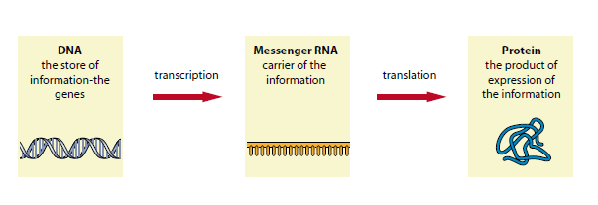
Gene expression
This can be thought of as the process of copying the information in the DNA into messenger RNA and then translating the message into a series of amino acids to form a protein.

Slide 23
At any given time a cell is only making mRNA (and therefore proteins) from a fraction of its genes.
A gene that is being used to make mRNA is said to be “switched on”, while a gene that is not being used is said to be “switched off”.
Factors that affect whether genes are expressed include
the age of the cell,
signals from other cells,
the environment of the cell and
whether the cell is dividing.

Slide 24
Epigenetics
http://learn.genetics.utah.edu/content/epigenetics/intro/ or
http://www.youtube.com/watch?v=AV8FM_d1Leo
http://www.youtube.com/user/LearnGenetics#p/a/CBE7A398078F6E81/1/s7dDd1bvNfA
Epigenetics refers to the study of the factors, other than changes in the DNA structure that control gene expression.
There are three ways this occurs:
How tightly coiled the DNA is around the histones
Methylation
Acetylation

Slide 25
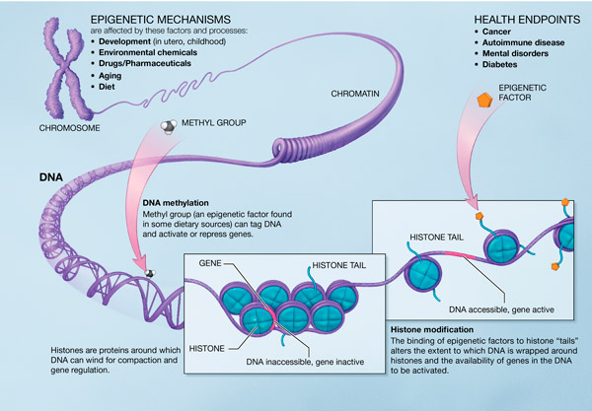
http://en.wikipedia.org/wiki/File:Epigenetic_mechanisms.jpg

Slide 26
1. How tightly coiled the DNA is around the histones
Histones are the proteins around which DNA is wrapped.
The way that the DNA is wrapped around the histones can affect the gene expression.
In particular if the DNA is tightly coiled around the histones it tends to switch the gene off. If the DNA is loosely coiled around the histone it tends to switch the gene on.
http://www.youtube.com/watch?v=eYrQ0EhVCYA

Slide 27
2. The methyl tags that exist in the DNA
A methyl tag is a chemical that can bind to some of the nucleotide bases.
1
This can inhibit gene expression (protein synthesis) OR (new) it can also enhance gene expression
2
However things like diet can change the amount of methylation.
3

Slide 28
3. The acetyl tags that exist in the DNA
An acetyl tag is a chemical that can bind to some of the nucleotide bases.
This can enhance gene expression (protein synthesis)

